Slide 1

EANGUS
2024 LEGISLATIVE WORKSHOP

Slide 2

2024 Legislative Workshop
WELCOME
AND
INTRODUCTIONS
Daniel Reilly, EANGUS President

Slide 3
MONDAY, 26 February 2024 Royal Sonesta Washington DC, West Atrium
20 Massachusetts Ave NW, Washington, DC 20001
0800 - 0815 Welcome Remarks – President Reilly
0815 - 0830 National Office Update – Executive Director Jeff Frisby
0830 - 0930 Capitol Hill 101 – Jeremy Thompson
0930 - 1000 Break (sponsored by EANGUS Corporate Partners)
1000 - 1130 From the Hill: Congressional Panel – Chris Bennett and Matt Reel from Rep. Mike Levin’s (CA) Office, and Nate Guajardo from Sen. Richard Blumenthal’s (CT) Office
1130 - 1300 Lunch
1300 - 1600 EANGUS CAP Meeting (Closed Session) – Alec Mizner
EANGUS Board Room
1300 - 1400 NGB LL Panel – CMSgt John Robey and CSM Harold Watts
1400 - 1500 Walmart- Jennifer Powell and Steve Foster
1500 - 1530 Break (sponsored by EANGUS Corporate Partners)
1530 - 1600 Firearms Legal Protection – Jeff Rogers
1600 - 1630 From the Grassroots Up: The EANGUS Resolutions Process – EANGUS Resolutions Team, Chris Rollins and Grant Roper
1630 - 1700 CAP Engagement - Alec Mizner
1700 - 1715 Daily Recap - President Reilly

Slide 4
TUESDAY, 27 February 2024 Royal Sonesta Washington DC, West Atrium
20 Massachusetts Ave NW, Washington, DC 20001
0800 - 0805 Welcome Remarks – President Reilly
0805 - 0900 EANGUS Legislative Director World Premier – Michael T Lane
0900 - 0930 Senior Enlisted Remarks – CSM John Raines
0930 - 1000 Penn State University - Malcolm Warbrick
1000 - 1030 Break (sponsored by EANGUS Corporate Partners)
1030 - 1130 EANGUS Point Paper Discussions – Jeremy Thompson, Jeff Frisby, and David Daniels, IV
1130 - 1200 Travel to Conflict Kinetics (Invite Only)
1200 - 1330 Lunch on your own
1345 - 1545 Staff led Capitol Tour (20 Pax, Junior Enlisted)
1300 - UTC Hill Visits
WEDNESDAY, 28 February 2024
0800 - 1700 Hill Visits
1700 - 1900 Congressional Awards Reception Rayburn House Office Building
Gold Room, Room 2168

Slide 5

Thank you to our Sponsors and Exhibitors!
Affinity Partner

Slide 6

Thank you to our Sponsors and Exhibitors!
Affinity Partner

Slide 7




Thank you to our Sponsors and Exhibitors!

Slide 8




Thank you to our Sponsors and Exhibitors!

Slide 9




Thank you to our Sponsors and Exhibitors!

Slide 10

2024 Legislative Workshop
National Office Update
Jeff Frisby, Executive Director

Slide 11
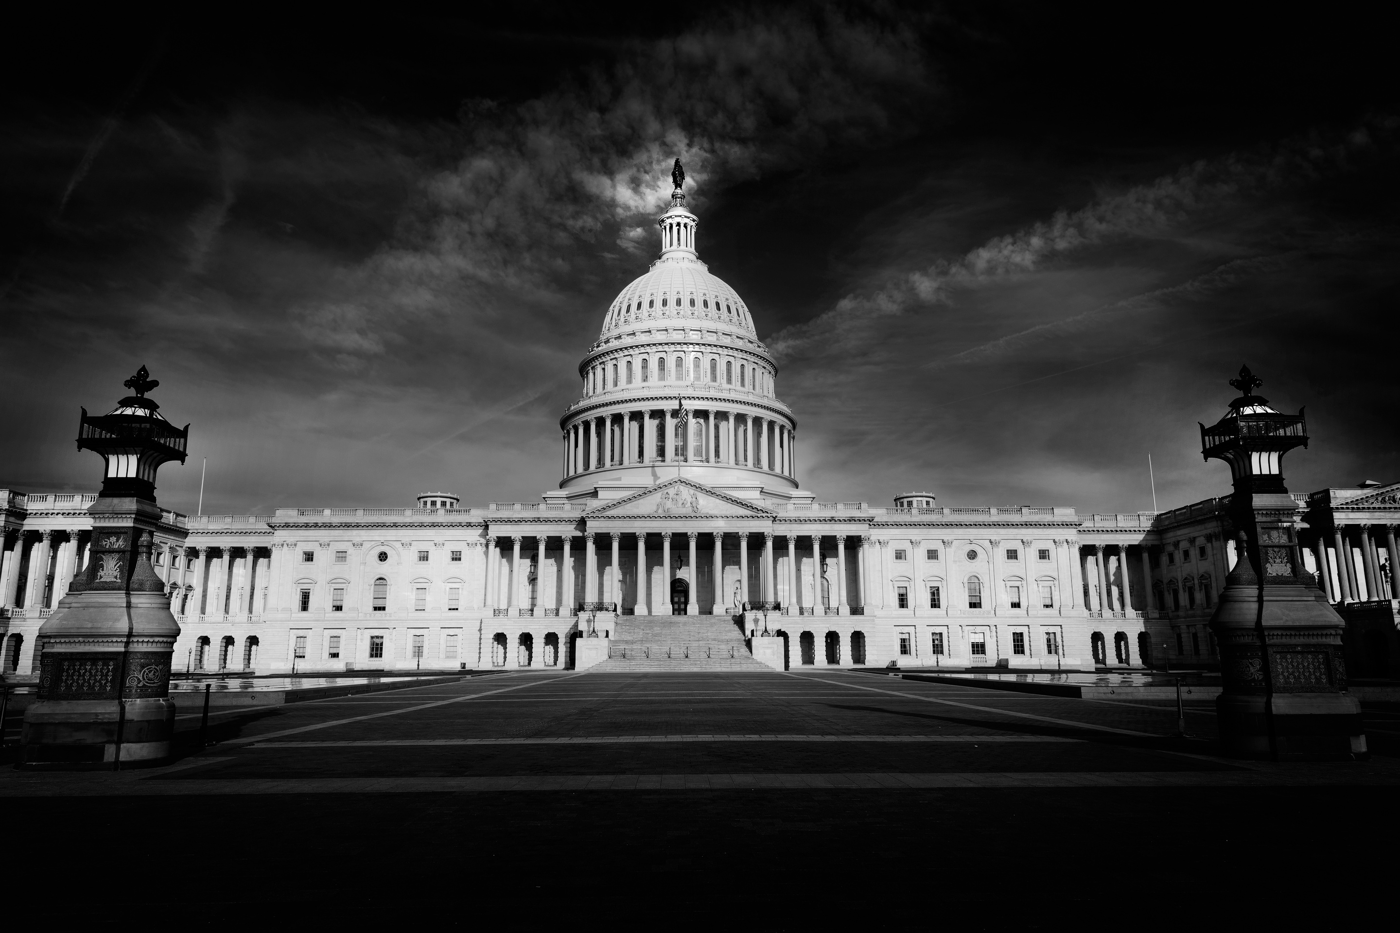




EANGUS
PRESIDENTS WORKSHOP 2024
WWW.EANGUS.ORG
JEFF@EANGUS.ORG

Slide 12


NATIONAL OFFICE UPDATE
RE-ORGANIZATION OF THE NATIONAL OFFICE
  Hired a new Legislative Director, Michael T. Lane (UT)
  Hired a new Manager of Legislative Affairs, David Daniels, IV (DC)
  Advertised the Media and Marketing Director
  Developing clear roles for the office employees
  Exploring a Business Development Position
  Weekly Staff meetings (Mondays @ 14:30)
LEGISLATIVE EFFORTS
  Keeping a schedule of visiting with your Congressional Delegates
  Cleaning up our Point Papers
  Maximizing the use of VoterVoice
PROVIDING MORE SUPPORT FOR THE STATES
  Stronger communications
  In person support
  Sharing resources and updates
WE CARE FOR AMERICA
  Continuing to support Soldiers, Airmen, and Families
  National Guard Relief Foundation

Slide 13






EANGUS NATIONAL OFFICE LINES OF EFFORT
Professional, effective, and relevant EANGUS National Office that is responsible to the board of directors, partners, state associations, and the EANGUS membership by developing a reputation as a world leading advocate for the National Guard.
MEMBERSHIP
-LIFE, ANNUAL, ASSOCIATE MEMBERSHIPS
-LEGACY DONATIONS
-MEMBERSHIP GOALS
-NEW TO EANGUS MEMBERSHIPS
-PENDING PAYMENTS
-MARKETING CAMPAIGNS
EVENTS
- GOLF OUTING
- 5K
- LEG SUMMITS
- RAFFLES
COMMUNICATIONS
- POD CASTS
- MMU
- DWTP
- PCI
- ED UPDATE
- NEW PATRIOT
- LEGISLATIVE
REPORTS
RESPONSIBLE TO
THE STATES
PROFESSIONAL FOOTPRINT
- WEBSITE
- OFFICE
- USE OF
TECHNOLOGY
POLICIES
OFFICE
GUIDELINES
LEGISLATIVE
-REPUTABLE STAFF/ ENGAGEMENTS
-VOTERVOICE AND CALLS TO ACTION
-VALUABLE WORKSHOPS
-ENGAGEMENT REPORTS
-STATE ENGAGEMENTS
-TIMELY INFORMATION
SHAPING EFFORTS
CONFERENCES
-MARKETING
-AGENDAS
-EVENTS
-INNOVATIVE
-PRESIDENTIAL INVITES
-INDUSTRY
-GOALS
PARTNERSHIPS
-RELEVANT TO MEMBERS
-INVOLVED WITH THE STATES
-RENEWAL SCHEDULES
-PROSPECTUS
-CAP INVOLVEMENT
-INNOVATIVE OUTSIDE GROUPS
-GOALS
9/11 GALA
-INFO TO THE STATES
-ENTERTAINING
-HIGH PRESTIGE/MEDIA COVERAGE
-GOALS

Slide 14
EANGUS
PRESIDENTS WORKSHOP 2024
WWW.EANGUS.ORG
JEFF@EANGUS.ORG

Slide 15
2024 Legislative Workshop
Capitol Hill 101
Jeremy Thompson, EANGUS Legislative Chair

Slide 16
Capitol Hill 101
SFC(Ret) Jeremy Thompson – Legislative Committee Chair

Slide 17
Capitol Hill 101 Content
Why are we here?
  To establish and maintain legislative priorities that benefit “Enlisted” members of the Army and Air National Guard
  Because our chartered Mission Statement reads “Promote, safeguard, and improve the status, welfare, and professionalism of enlisted National Guard members, veterans, retirees, and their families
What makes us successful?
  Having detailed knowledge of our point papers and resolutions.
  Knowing how to engage congressional members and staff in productive conversations that compel them to act on behalf of EANGUS.
Understanding the Legislative Process
  Budget
  Continued Resolution
  NDAA National Defense Authorization Act
  CBO Scoring
  Video on How a Bill becomes Law

Slide 18
Capitol Hill 101 Budget
1974 CONGRESSIONAL BUDGET ACT
Timetable of the congressional budget process (in law, if not always in practice)
First Monday in February: President submits proposed budget.
Feb. 15: Congressional Budget Office submits report on economic and fiscal outlook to the House and Senate budget committees.
Six weeks after president submits budget: Other House and Senate committees submit their views and estimates to the budget committees.
April 1: Senate Budget Committee reports concurrent resolution on the budget.
April 15: House and Senate agree to a concurrent resolution on the budget.
May 15: Annual appropriations bills may be considered in the House.
June 10: House Appropriations Committee reports its last annual appropriations bill.
June 15: Congress completes action on reconciliation legislation.
June 30: House completes action on all annual appropriations bills.
Oct. 1: Fiscal year begins; all annual appropriations bills enacted by this date.

Slide 19
Capitol Hill 101 CR vs Budget
How is a CR different from a budget?
The federal budget is a proposal by the President outlining spending goals and priorities during a given year. Congress debates this funding, and then votes to appropriate funding. However, Congress has only completed this process before the beginning of the fiscal year 3 times in the last 47 years, most recently for FY1997.
CRs generally continue the level of funding from the prior year’s appropriations or the previously approved CR from the current year. Full-year CRs provide appropriations for the remainder of the fiscal year and are functionally similar to final appropriations. A CR can include changes from the prior year’s budget that could (1) alter the rate at which funds are utilized, (2) extend an expiring program authority, or (3) provide a specific dollar amount of funding to a program during the CR.
How often does Congress pass a CR and why?
A CR is needed any time that Congress and the President do not reach agreement on the spending levels and enact regular appropriations by the start of the federal fiscal year in October. There have been 47 CRs between FY 2010-2022. These ranged from 1 to 176 days (just under 6 months). On three occasions—in FYs 2014, 2018, and 2019—no CR was approved, resulting in a shutdown. As previously stated, the federal government is currently under a CR for FY 2023 that expired December 16, renewed January 18, up again March.

Slide 20
Capitol Hill 101 Congressional Budget Office
There are 16 Scorekeeping Guidelines
These budget scorekeeping guidelines are used by the House and Senate Budget Committees, the Congressional Budget Office, and the Office of Management and Budget (the "scorekeepers") in measuring compliance with the Congressional Budget Act of 1974 (CBA), as amended; the Balanced Budget and Emergency Deficit Control Act of 1985 (BBEDCA), as amended; and the Statutory Pay-As-You-Go Act of 2010. The purpose of the guidelines is to ensure that the scorekeepers measure the effects of legislation on the deficit consistent with established scorekeeping conventions and with the specific requirements in those Acts regarding discretionary spending, direct spending, and receipts.

Slide 21
Capitol Hill 101 NDAA
National Defense Authorization Act
The National Defense Authorization Act (NDAA) is an annual bill that lets Congress set guidelines for defense policy12. It is passed every year and covers just about every aspect of military family life, including pay, benefits, TRICARE, and the commissary. Though funding for the U.S. military must be approved through appropriations bills, Congress uses the NDAA to establish defense priorities, make organizational changes to military agencies, and provide guidance on how funding should be used.

Slide 22
Map of Capitol Hill
Senate Office Buildings
  Russell 2 Constitution Ave NE
  Dirksen 50 Constitution Ave NE
  Hart 120 Constitution Ave
House Office Buildings
  Longworth 15 Independence Ave SE
  Cannon 27 Independence Ave SE
  Rayburn 45 Independence Ave SW
NOTE: Call your State CODELs and schedule appointments ahead of time and know what committees and sub committees they serve on.

Slide 23
Capitol Hill 101
Video on the Bill Making Process
(104) How a Bill Becomes a Law: Crash Course Government and Politics #9 - YouTube
SFC(Ret) Jeremy Thompson – Legislative Committee Chair

Slide 24
2024 Legislative Workshop
BREAK

Slide 25
From the Hill: Congressional Panel
Chris Bennet- Rep. Mike Levin (CA)
Matt Reel- Rep. Mark Takano (CA)
Nate Guajardo- Sen Richard Blumenthal (CT)

Slide 26
2024 Legislative Workshop
LUNCH

Slide 27
NGB LL Panel
CMSgt John Robey
CSM Harold Watts
Notes:
People Mover: $1.50 per person, per day, unlimited rides
Q-Line:
Fast Bus: $2.00 per person, per ride

Slide 28
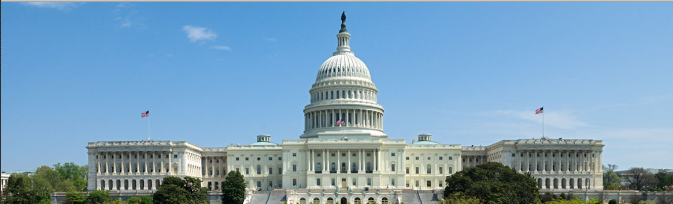
National Guard Bureau
Office of the Legislative Liaison
21 FEB 2024
Mr. Joshua Spann
Associate Director, NGB-LL

Slide 29
NGB-LL Roles & Responsibilities
What We do:
Serve as a THE conduit of communication between Congress, its agencies, and the NGB
Inform and educate Congress on National Guard plans, programs, budget, policies, activities, and issues
Advise the CNGB and other senior NGB leaders on congressional activities which may impact National Guard interests
Manage the NGB’s legislative program:
  Deliberate legislative planning (i.e. congressional objectives)
  Legislative proposal development
  Preparation for testimony
  Responding to formal congressional correspondence (inquiries)
  Coordinate across Service Components and OSD legislative affairs
What We Don’t Do:
Advocate for policies/programs outside President’s Budget, or contrary to Administration position
Portray ourselves as subject matter experts
LOBBY
29

Slide 30
Key Players
Members of Congress
  Focused on major issues, jobs at home, and constituents
  Rarely interested in programmatic or technical detail
  Influences professional staff
Professional Staff (Committee Staff)
  Day-to-day keeper (and gatekeeper) of committee issues and awareness
  Primary contact for most issues
  Work for committee chair or ranking member
  Focus on committee jurisdiction; mindful of committee leaderships’ constituency
Personal Staff (Office Staff)
  Military Legislative Assistant (MLA)
  Defense Fellows
  Keeper of member-interest information
  Focus on issues important to the member
  and their district
30

Slide 31
Key Committees
Armed Services
Appropriations
Defense Authorization Committees
  SASC: Senate Armed Services Committee
  HASC: House Armed Services Committee
National Defense Authorization Act (NDAA)
  Provides end strength numbers, pay rates, benefits and other policy guidance
  May clarify purpose of appropriation (i.e. funding restrictions, establishing new agency, etc.)
Defense Appropriations Subcommittees
  SAC-D: Senate Appropriations Defense Subcommittee
  HAC-D: House Appropriations Defense Subcommittee
MILCON Appropriations Subcommittees:
  HAC-MILCON: House Appropriations Subcommittee on MILCON, Veterans Affairs, & Related Agencies
  SAC-MILCON: Senate Appropriations Subcommittee on MILCON, Veterans Affairs, & Related Agencies
Appropriations Act
  Directs treasury to release funds to agencies as provided in the bill
  Supposed to be tied to NDAA; not always the case
31

Slide 32
Congressional Objectives & Legislative Proposals
Congressional Objective (CO)
COs are organizational objectives that enable the CNGB to realize his vision. COs synchronize and prioritize NGB’s efforts relative to the Congress. There is a formal process for NGB Directorates to provide recommendations for CNGB’s consideration and ultimate approval.
Legislative Proposal (LP)
LPs are formal proposals for Congress to consider changing an existing law or provide additional authorities. LPs are ultimately approved by the Administration and are traditionally transmitted to Congress in tranches in coordination with the Presidential Budget release. There is a formal Executive Branch process to submit LPs to Congress for consideration, which requires DoD, OMB, and NSC approval.

Slide 33
Congressional Synchronization Calendar
Year of Execution
Jan | Feb | Mar | Apr | May | Jun | Jul | Aug | Sep | Oct | Nov | Dec
HASC Hearings
HASC Markup
Floor
Conference Committee
Floor
POTUS
Signs
SASC Hearings
SASC Markup
Floor
Floor
New Member Orientation (election years)
Congress
SOTU
Pres
Bud
HAC Hearings
HAC Markup
Floor
Conference Committee
Floor
POTUS
Signs
New Congress Admin Period (election years)
SAC Hearings
SAC Markup
Floor
Floor
Budget Rollout Briefs
Appeal of Committee Marks (SAP/Heartburn)
Summer Recess
Develop LP Concepts
(Call for LPs in Nov)
Develop Full LPs
LP Internal Review
CNGB Approves LPs
LL submits LPs
DoD and Interagency LP coord and adjudication
Previous years LPs transmitted to Congress
Develop LP Concepts
(Call for LPs in Nov)
OMB LP coord and adjudication
Staff develops posture hearing materials
CNGB/Director prep sessions
CNGB Posture Hearings
LL leads hard Q&A sessions
Hearing QFRs and IFRs
CNGB and Senior Leader CO engagements to shape NDAA and Appropriations Markup
CNGB and Senior Leader CO engagements in response to NDAA and Appropriations Markup
LL leads CO Development for Upcoming Cycle
LL Develops CO Engagement Plans
NGB-LL
AO-level CO shaping engagements
CO message testing
Education Series
Education Series
Education Series
Education Series
Education Series
New member calls (election years)
Senate NG Caucus Breakfast
EANGUS
33
NG BDay

Slide 34
How NGB-LL Interacts with Congress
Synchronization & Coordination
Outcome
Direct Engagements
CO/LP
Official Correspondence
CO/LP
Testimony
Public Statements & Announcements
CO/LP

Slide 35
Congressional Objectives
FY 2025
These inform the FY25 National Defense Authorization Act (NDAA) and FY25 Defense Appropriations
  PEOPLE
  Attract and Retain Talent within the NG
  Healthcare Coverage for NG Members (SUSTAIN)
  READINESS
  Future of the Total Force Optimization - Mix and Integration
  NG Infrastructure
  MODERNIZATION
  ANG Modernization (SUSTAIN)
  ARNG Modernization Requirements (SUSTAIN)
  National Guard and Reserve Equipment Account (NGREA)
  REFORM
  State Partnership Program (SPP)

Slide 36
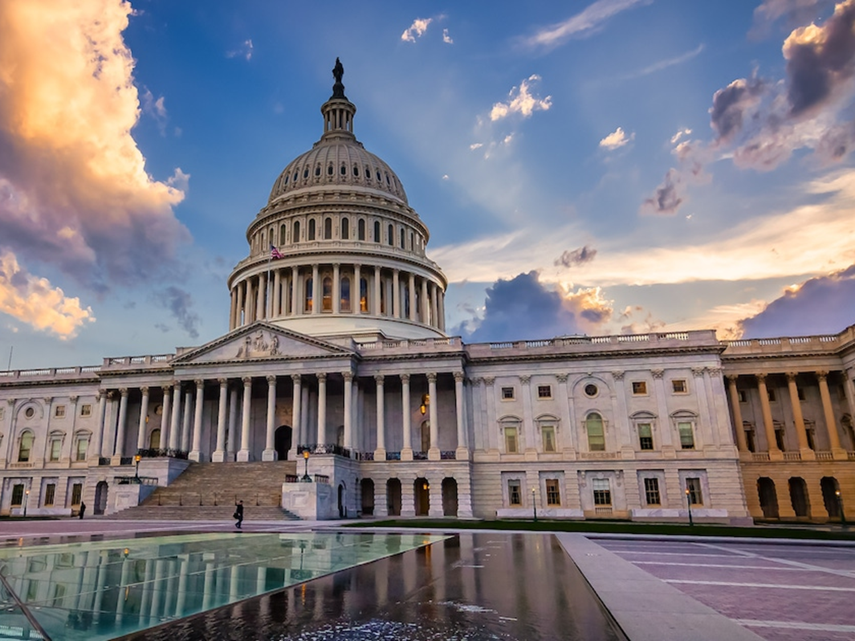
Questions

Slide 37
Jenifer Powell
&
Steve Foster

Slide 38
Walmart and EANGUS
An Overview of Collaborative Methods and Strategies: How We Work Together

Slide 39






Walmart Military Programs
Employment
Entrepreneurship
Education
Community Support
Wellness
Our Associates
Walmart Inc.

Slide 40
Ways to work with Walmart
Local Stores/Community
Home Office
National Sponsorships
Hiring and entrepreneurship initiatives
Legislative seminars
Connection
State or local Sponsorships
In-kind donations and volunteer opportunities
Hiring fairs
Walmart Inc.

Slide 41

Steve Foster
Senior Director/Market Manager,
Western Arkansas/Eastern Oklahoma
Walmart Inc.

Slide 42


GREAT Jobs
Donations
.Local store donations
Volunteers
Associate volunteers for events and service projects
Direct access to great jobs for soldiers, airmen, and their families
Sponsorships
Conference or gala sponsorships
Grants
Community grants and Volunteerism Always Pays
Retail Expertise
Subject matter expertise in retail operations (guidance for PX/Exchange leadership)
Potential Benefits of Operations Relationships
Walmart Inc. Confidential — Internal use only
5

Slide 43
Engagement Examples
Visit
Explain
Invite
Ask
Visit local store, distribution center, or Sam’s Club and speak directly with the facility manager
Explain your organization and mission
Invite facility manager to be part of an upcoming event on base
Ask local store manager to connect you with the Market Manager in your area – Market Managers have responsibility for 8-14
stores (2,000-4,000+ associates or potential volunteers)
Walmart Inc.

Slide 44
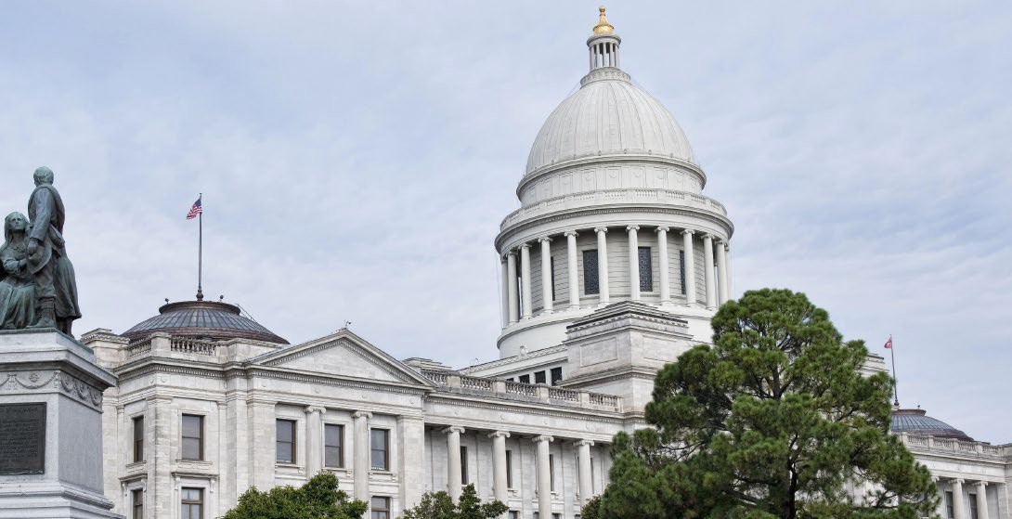
Legislative Workshop
Goal(s)
Strategy
Location
Invitees
Discussion topics
What are the
What are the
What is the
Who should we
What should
short-term
long-term
significance
invite, and will
we discuss?
session goals?
relationship
of location?
they come?
goals?
Know your state.
Focus on what is
In AR, focuses
A partner can
important to the
were raising NG
Remember to
Where and when
help with officials.
NG. In AR,
awareness about
focus on
you host the
Know which state
Ashley wrote a
which issues are
relationship
session will
or local legislators
draft script and
state vs. federal
building first –
determine
are veterans or
we helped clean
and giving
layer on specific
attendance.
champion veteran
it up, ensuring
visibility to
asks as the
Consider things
issues. Keep
that content was
state/local
relationships
like whether the
session short and
appropriate for
officials about
mature.
legislature is in
offer
each official
NG challenges,
session and what
refreshments if
participating.
initiatives, and
district you’re
you can.
provided
thinking of
services.
hosting in.
Walmart Inc.

Slide 45
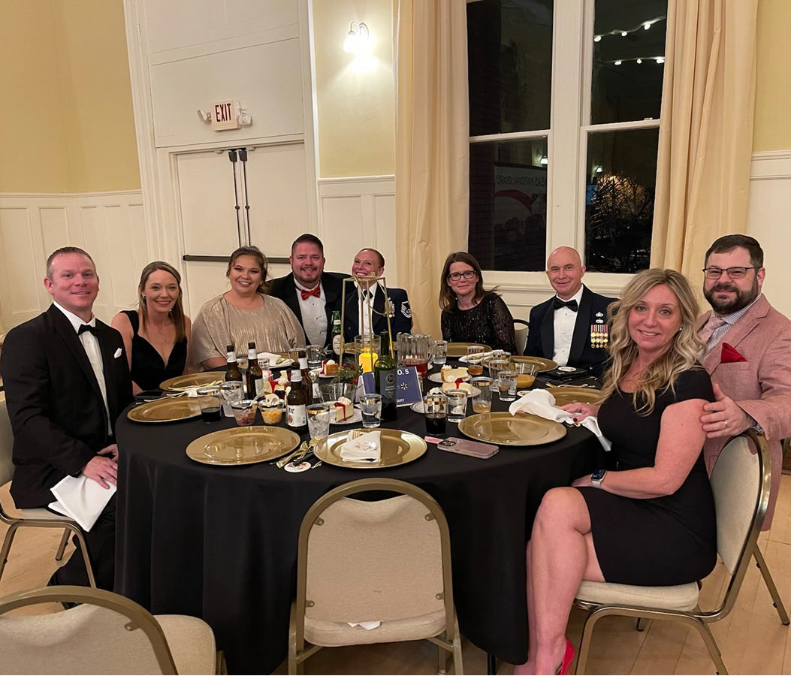
Appendix
8

Slide 46


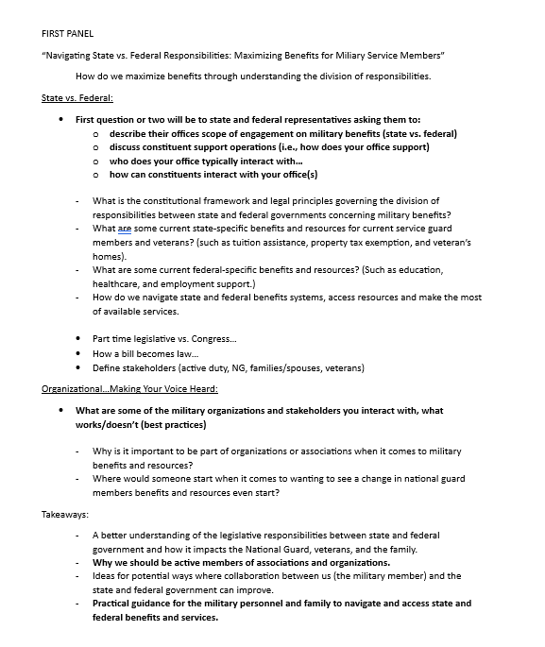
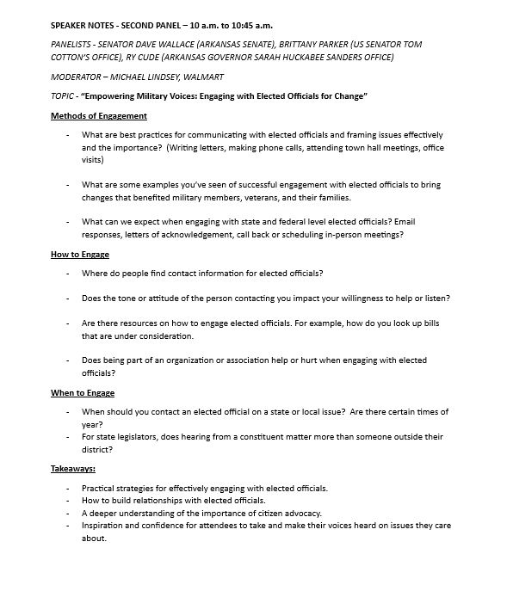
Arkansas Legislative Workshop – Sample Questions
Walmart Inc.

Slide 47
Walmart Legislative Examples - Federal
Federal
In order to enhance beneficiary access to TRICARE pharmacy services, we are advocating for improvements to the TRICARE pharmacy network. As part of the FY 24 NDAA bill report, Congress has instructed the Comptroller General to review the TRICARE pharmacy benefits program and present a briefing by March 31, 2024. This review is expected to reveal a decrease in access, which will further underscore the urgency of enhancing network adequacy requirements.
We are advocating for policies to reduce food insecurity among military personnel and their families. One such policy, included in the final version of the FY 24 NDAA, is language (Sec. 621) that would grant the Department of Defense (DoD) the ability to adjust how gross household income is calculated. This calculation is used to determine the Basic Needs Allowance (BNA), which is a monthly payment that helps qualifying service members afford basic necessities. By modifying the income calculation, the BNA can provide additional support to families with lower incomes.
Improve veterans access to community care
Walmart Inc.

Slide 48
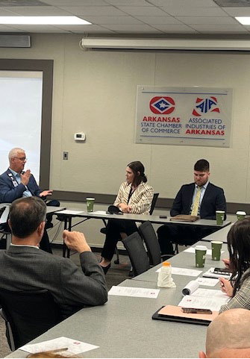
Walmart Legislative Examples - State
State/Federal
Advance policies that promote access to in-person and virtual behavioral health services
State
Improve occupational licensing and certification processes for working military spouses, e.g.,:
  Support cross-state initiatives to align licensing
  Increase coordination across regulatory boards
  Increase license portability (interstate compacts)
  Streamline licensing process and lower fees
Walmart Inc.
11

Slide 49
Additional Resources
Find a Future - https://walmartfindafuture.com/
Walmart Corporate Veteran Site - https://Walmart.com/veterans
Supplier Inclusion - https://corporate.walmart.com/suppliers/supplier-inclusion Walmart Foundation - https://walmart.org/
Walmart Spark Good - https://walmart.org/what-we-do/strengthening-community/spark-good
Walmart Inc.
12

Slide 50
2024 Legislative Workshop
BREAK

Slide 51
Jeff Rogers

Slide 52



GAIN SHARE PARTNERSHIP

Slide 53
The “Three Fights”
Physical
Psychological
Legal

Slide 54
The “Cost” of Lethal Force
Physical—could be your life! Prepare!
Psychological—aftermath of shootings leaves 50% divorce rate; 50% unemployment rate; 8% suicide rate! Prepare for this to not include you!!
Legal—even a justified shooting can result in serious CR charges—see Zimmerman, Rittenhouse, et al. How much does that cost? Can be MILLIONS!

Slide 55
Legal Cost
Average PRETRIAL cost for a middling firearms related Felony is going to be $30,000.
Add AT LEAST another $100,000 if the case proceeds to trial.
How in the world can someone afford this?

Slide 56
DO NOT BE THE PERSON WHO PAYS FOR YOUR LAWYER’S NEXT HOUSE! BE SMART!

Slide 57
Pre-Paid Legal Fees
Homeowner’s/Auto will NOT cover it—yes—even if you have an umbrella policy!
You need Self Defense, pre-paid legal expenses Coverage!
Best option on the market is…..

Slide 59
ABOUT Firearms Legal Protection
Based in Dallas, Texas.
We are not a training company or publication company. We specialize in legal defense.
You don’t need a carry permit to be a member.
We cover defenders who use any legal weapon, not just firearms.
This is NOT insurance .. NO charge backs for legal fees for a loss case or plea deal.

Slide 60
FIREARMS LEGAL PROTECTION cont’d
Firearms Legal Protection provides uncapped legal defense coverage for its members who legally use a firearm (or any legal weapon) in self-defense, or the defense of others.
Unfortunately, when people use a firearm in self-defense they could get arrested, put in jail, and face extensive legal costs.
Firearms Legal Protection provides members with peace of mind in these difficult situations by providing uncapped attorney fees for as little as 73cents per day (Ind Premium Plan), and other benefits such as bail bond protection. Firearms Legal protection operates a 24-hour attorney answered emergency hotline for members.

Slide 61
ALL PLANS INCLUDE:
24/7 Emergency Hotline – answered by an attorney, NOT an answering service. Immediate client Attorney privilege.
Uncapped attorney fees for criminal and civil cases. You will NEVER pay a penny for your defense.
This is NOT a reimbursement program. FLP will pay the attorney directly.
You don’t have to have a carry permit or own a gun to be a member.
MyFLP APP gives you instant access to laws and legal questions 24/7 for all 50 states.

Slide 62

OUR ATTORNEYS
Nationwide Defense Network.
Vast network of criminal and civil defense attorneys.
All attorneys have a minimum of 5 years of TRIAL experience in gun laws and related cases.

Slide 63
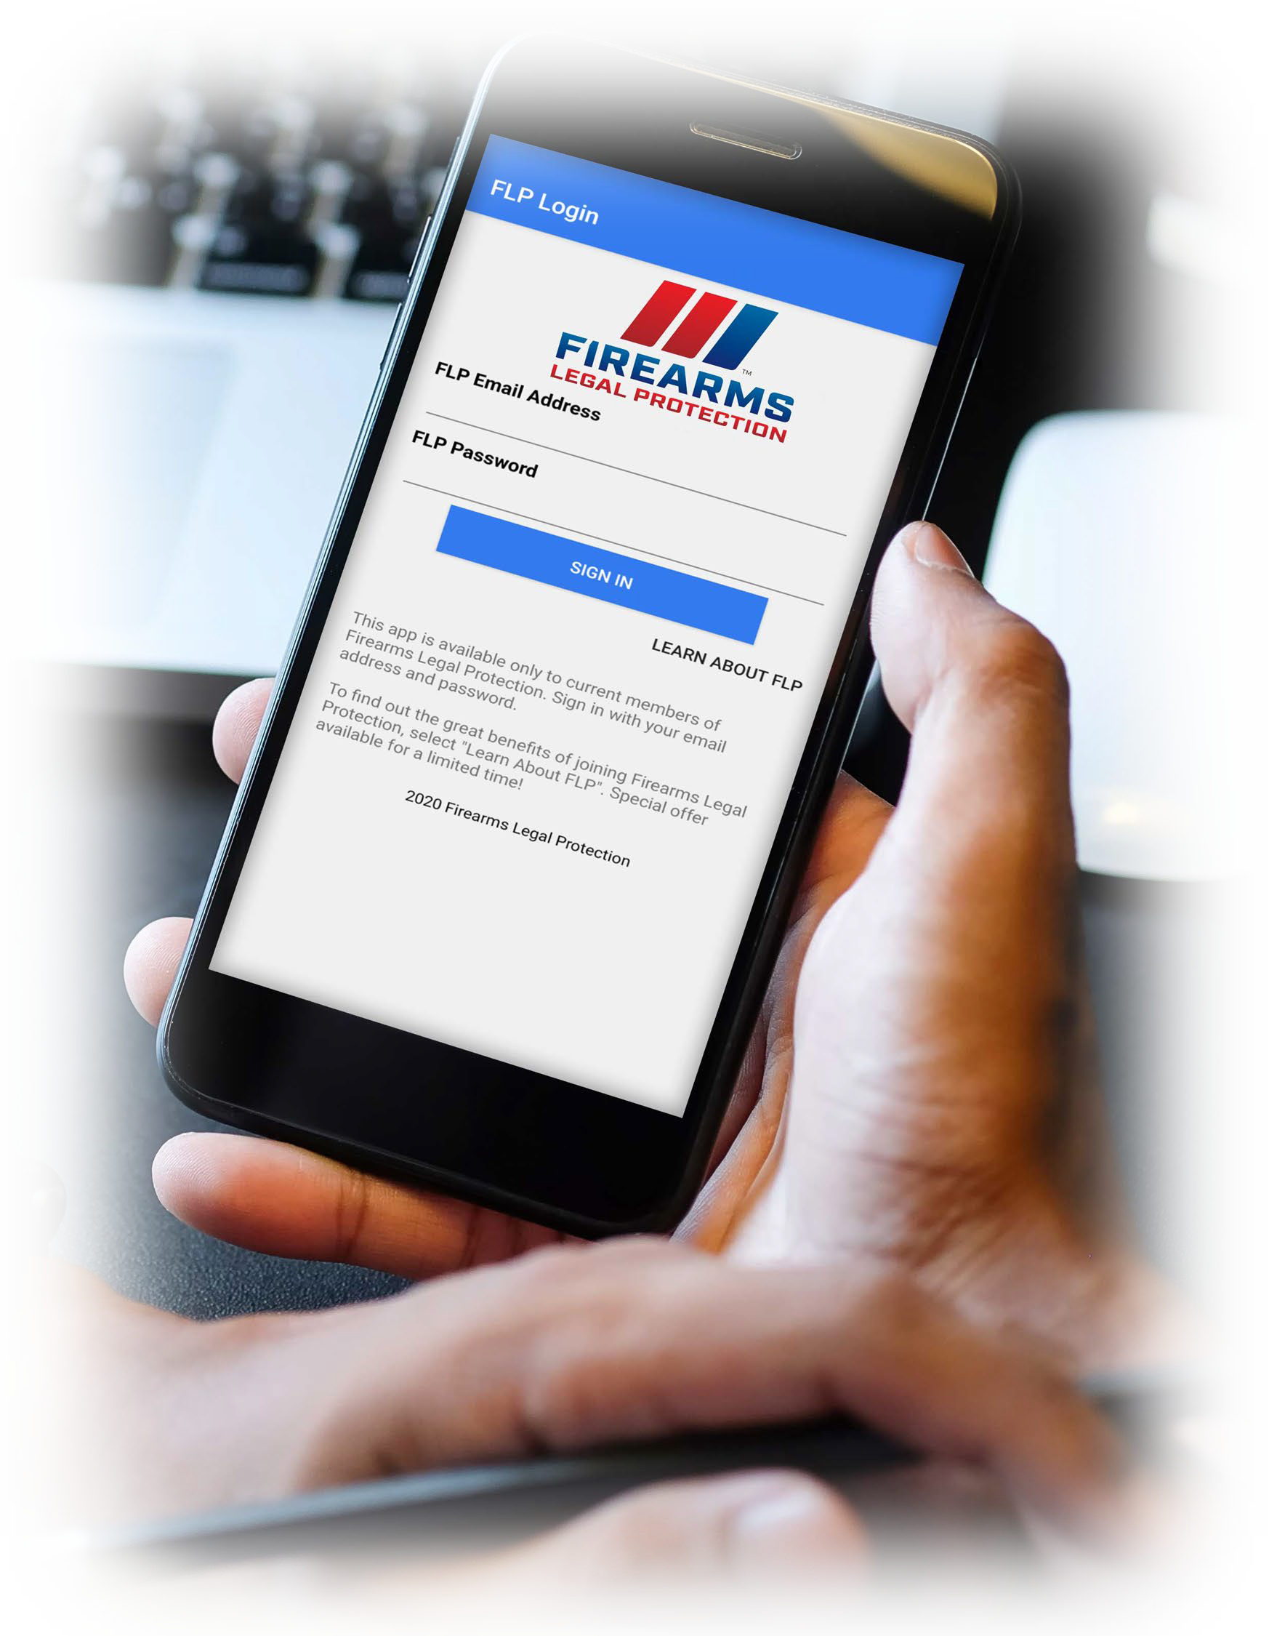
MyFLP MOBILE APP
Easy to use “Emergency” and “Customer Support” contact buttons.
State by state reciprocity maps.
Submit legal questions to attorneys.
Recent law updates.

Slide 64
PROTECT YOURSELF. FLP WILL PROTECT YOU.

Slide 65
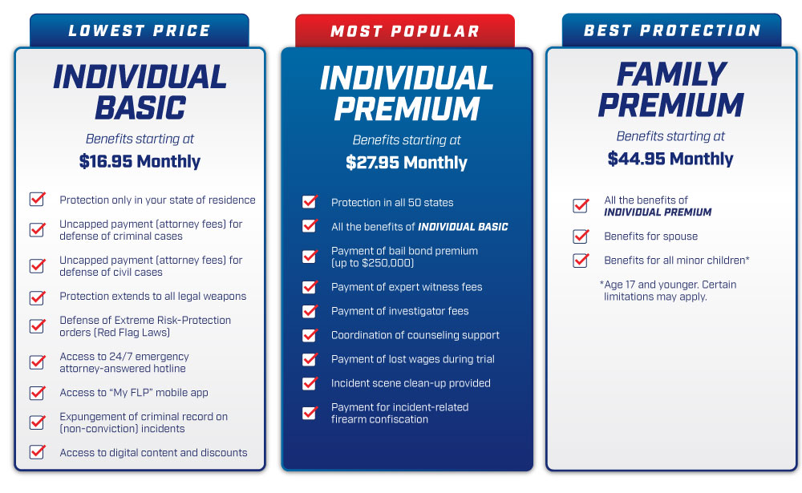

Slide 66
GAIN SHARE

Slide 67
GAIN SHARE OPP i.e., EANGUS/EANGTN
 | EANGUS GAIN SHARE
Indvidual Premium Plan | 5% Gain Share/10% Capture | 5% Gain Share/5% Capture
Memebrship 40,000
Gain Share From $21.95 | $1.10 | $1.10
New Members | 4000 | 2000
EANGUS 12mth Rev | $4,400 | $2,200
30mth Rev Capture | $132,000 | $66,000
Total EANGUS Gain Share | $136,400 | $68,200
 | EANGTN Gain Share
Individual Premium Plan (most popular) | 5% Gain Share/50% Capture
Total EANGTN Membership 3270
Gain Share From $21.95 | $1.10 | 5% Capture
New Members | 1635 | 164
EANGTN recurring MTHLY Rev | $1,798 | $180
12mth Rev Capture | $21,560 | $2,160
30mth Rev Capture | $53,955 | $5,400
Total EANGTN Gain Share | $75,515 | $7,560
Family Plan (2nd most popular) | 5% Gain Share/50% Capture
Total EANGTN Membership 3270
Gain Share from $38.95 | $1.95
New Members | 1,635
EANGTN recurring MTHLY Rev | $3,188
12mth Rev Capture | $38,256
30mth Rev Capture | $95,640
Total EANGTN Gain Share | $133,896
Individual Basic Plan (3rd most popular) | 5% Gain Share/50% Capture
Total EANGTN Membership 3270
Gain Share From $9.95 | $0.50
New Members | 1,635
EANGTN recurring MTHLY Rev | $817
12mth Rev Capture | $9,804
30mth Rev Capture | $24,510
Total EANGTN Gain Share | $34,314
All EANGTN members get a discounted price from our published plan fees, as follows:
1) Individual Premium $21.95 vs $27.95
2) Family Plan $38.95 vs $44.95
3) Individual Basic $9.95 vs $16.95

Slide 68
From Grassroots up:
The EANGUS Resolutions Process
ENLISTED ASSOCIATION OF THE NATIONAL GUARD OF THE UNITED STATES
LEGISLATIVE WORKSHOP
25 February 2024
Presenters:
Resolutions Committee Chair: Chris Rollins
Resolutions Committee Vice Chair: Grant Roper
WHERE MEMBERSHIP MATTERS

Slide 69
What is a Resolution?
ENLISTED ASSOCIATION OF THE NATIONAL GUARD OF THE UNITED STATES
Resolutions, or legislative proposals, are the driving force of our organization's legislative efforts. Resolutions are generated at the state level, reviewed by EANGUS Area representatives (Area Chair or Area Resolutions Chair), and are incorporated into the legislative agenda of EANGUS upon adoption at the EANGUS Annual Conference.

Slide 70
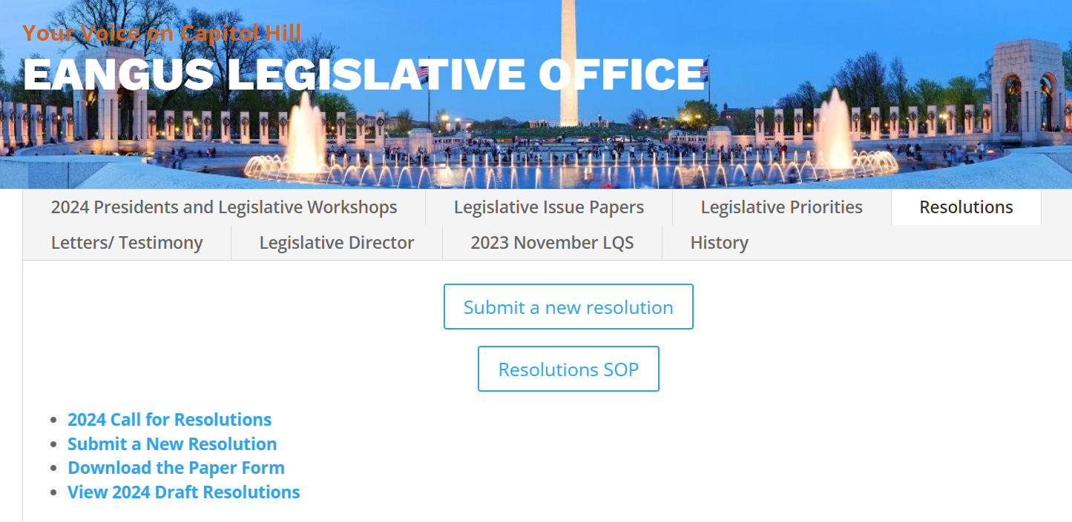

How the Resolution Process works
ENLISTED ASSOCIATION OF THE NATIONAL GUARD OF THE UNITED STATES
Call for Resolutions – Emailed out on 20 FEB 24
  Also, on the website here:
    https://eangus.org/legislative

Slide 71
How the Resolution Process works
ENLISTED ASSOCIATION OF THE NATIONAL GUARD OF THE UNITED STATES
EANGUS calls on all state and territory chapters to begin submitting resolution proposals (draft resolutions) States shall submit all draft resolutions NO LATER THAN (NLT) 15 May 2024.
Area representatives must review and forward (or electronically approve) all draft resolutions to the EANGUS Resolutions Committee Chair NLT 30 May 2024 to be considered at the 2024 EANGUS Annual Conference.

Slide 72
How the Resolution Process works
ENLISTED ASSOCIATION OF THE NATIONAL GUARD OF THE UNITED STATES
Draft resolutions may be electronically submitted using the web form at https://eangus.org/resolutions-submission-form/. Alternatively, PDF or Word form submissions will still be accepted in accordance with the current Resolutions SOP. The required forms are RESCOM Form 1 and EANGUS Resolutions Form.

Slide 73
New Workflow for Resolutions
ENLISTED ASSOCIATION OF THE NATIONAL GUARD OF THE UNITED STATES
Submitter from State Submits
Submitter gets an email confirmation w/ PDF copy of their submission
Resolutions will get a notification that something has been submitted
If area has not approved within 7 days, the system will send a reminder to the area email address
Once approved by area, resolutions will get a notification for final approval and assign draft resolution number
Draft resolution will appear on the website public view

Slide 74
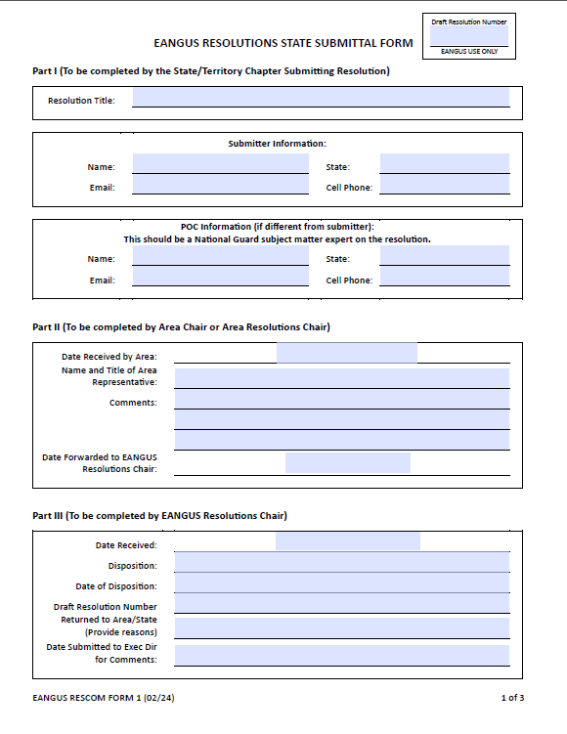
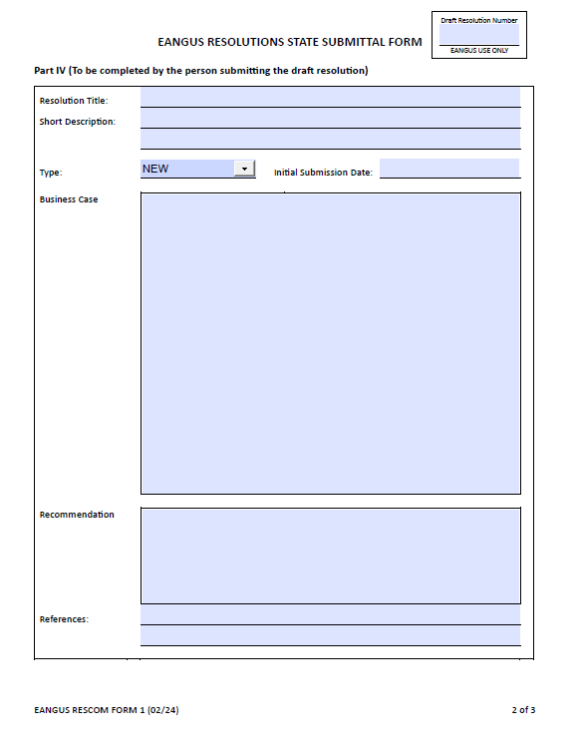
EANGUS Resolutions State Submittal Form
ENLISTED ASSOCIATION OF THE NATIONAL GUARD OF THE UNITED STATES

Slide 75

EANGUS Resolutions State Submittal Form
ENLISTED ASSOCIATION OF THE NATIONAL GUARD OF THE UNITED STATES
Online Submittal example
Resolutions Submission Form | EANGUS

Slide 76
ENLISTED ASSOCIATION OF THE NATIONAL GUARD OF THE UNITED STATES
Drafting a Resolution
Each draft resolution shall be submitted with all required fields, including the following:
- Title: This is the working title of the draft resolution
- POC Information: This should be a National Guard subject matter expert on the issues pertaining to the draft resolution. Entry must include an email and phone number. This person may be contacted to discuss the resolution
- Short Description: A one-paragraph or less description of the draft resolution

Slide 77
Drafting a Resolution
ENLISTED ASSOCIATION OF THE NATIONAL GUARD OF THE UNITED STATES
- Proposal Type: New, Change, or Resubmission. New submissions are draft resolutions that do not pertain to any currently adopted EANGUS resolution. Change submissions are draft resolutions that modify a previously submitted resolution. Resubmissions are draft resolutions that mirror a previously adopted resolution; these may add updated or additional background information but do not modify the recommendation or intent of the original resolution.
- Submitter: The primary state sponsoring the draft resolution. Several states may co-sponsor a draft resolution, but a primary state sponsor is required.

Slide 78
Drafting a Resolution
ENLISTED ASSOCIATION OF THE NATIONAL GUARD OF THE UNITED STATES
- Business Case: This should include a concise justification for the draft resolution, including affected states and personnel, intended purpose, status, history, and any relevant additional information.
- Recommendation: This should state the ask: What is this draft resolution asking EANGUS to do?
- References: This should include references to any laws, policies, and regulations that contribute to the business case and/or recommendation of the draft resolution.

Slide 79
End State of Resolutions
ENLISTED ASSOCIATION OF THE NATIONAL GUARD OF THE UNITED STATES
- Submitted draft resolutions are available for membership review on the EANGUS website at https://eangus.org/2024-resolutions-proposals/. The EANGUS Resolutions Chair will add any manually submitted draft resolutions to the website listing upon Area review and acceptance.
- The Resolutions Committee Chair will ensure that all draft resolutions submitted using the web form are electronically forwarded to Area representatives (Area Chair or Area Resolutions Chair) for review.

Slide 80
Timeline for Resolutions
ENLISTED ASSOCIATION OF THE NATIONAL GUARD OF THE UNITED STATES
1 September – 31 December
- State Presidents identify their Resolutions Chair to their EANGUS Area Resolutions Chair or Area Chair
- EANGUS Area Chairs appoint their Area Resolutions Chair (or assume responsibilities of such)
- EANGUS President appoints/reappoints EANGUS Resolutions Chair
1 January – 15 February EANGUS Resolutions Chair distributes current
Resolutions Committee SOP in accordance with paragraph6 C (1) of the SOP
16 February –15 May State Presidents/Resolutions Committee Chairs
submit resolutions to EANGUS Area Resolutions Chair or Area Chair, utilizing EANGUS RESCOM Form 1.
16 February –30 May EANGUS Area Resolutions Chair submit their respective chartered state’s resolutions to the EANGUS Resolutions Chair utilizing EANGUS RESCOM Form 1.

Slide 81
Timeline for Resolutions
ENLISTED ASSOCIATION OF THE NATIONAL GUARD OF THE UNITED STATES
30 May – 7 June EANGUS Resolutions Chair submits proposed EANGUS Resolutions to EANGUS Executive Director and EANGUS Legislative Director, with info copy to the EANGUS President utilizing EANGUS RESCOM Form 2.
7 June – 14 June EANGUS Executive Director and/or EANGUS Legislative Director forward proposed EANGUS Resolutions to the affected agencies for comment, utilizing EANGUS RESCOM Form 2
14 June – 8 July Affected Agency Comment Period
8 July – 15 July EANGUS Executive Director and/or EANGUS
Legislative Director returns proposed EANGUS Resolutions to the EANGUS Resolutions Committee Chair, with the affected agency comments, ideally
posted to the EANGUS RESCOM Form 2

Slide 82
Timeline for Resolutions
ENLISTED ASSOCIATION OF THE NATIONAL GUARD OF THE UNITED STATES
16 July – 25 July EANGUS Resolutions Committee Chair distributes, via email, the Draft Resolutions Report to all state associations, members of the EANGUS Executive Council, EANGUS President, EANGUS Executive
Director, EANGUS Legislative Director and Legislative Committee Chair for review prior to the National Conference.
August EANGUS General Conference – Conduct Resolutions Committee meeting and provide General Conference attendees with final Resolutions
Committee Report for action.
September EANGUS Executive Director and/or EANGUS Legislative Director to distribute approved EANGUS Resolutions to the appropriate agencies.

Slide 83
2023 Resolutions
ENLISTED ASSOCIATION OF THE NATIONAL GUARD OF THE UNITED STATES
Submission Date | State | Resolution Title
14-Aug-23 | South Dakota | Preservation and Recapitalization of Aviation Equipment within National Guard
14-Aug-23 | Utah | Request for Each States Locality Salary Table to be reviewed and updated
31-Jul-23 | Texas | Veteran to Veteran Unused Post 9/11 GI Bill Transferability
1-Jul-23 | Michigan | Fighter Platform Preservation and Recapitalization for the Air National Guard
1-Jul-23 | Michigan | IED Survivability: Modular Vehicle Protection Platform
1-Jul-23 | Michigan | Modernization and Sustainment of the Army National Guard Controlled Humidity Preservation (CHP) Sites.
1-Jul-23 | Michigan | Secure tactical chat communication software systems
1-Jul-23 | Michigan | Weapon storage racks modernization
1-Jul-23 | Michigan | Secure tactical chat communication software systems
1-Jul-23 | Michigan | Army Email and Collaboration Platform Modernization
1-Jul-23 | Michigan | Small Arms Simulation Modernization
1-Jul-23 | Michigan | Call for Fire Trainer Modernization
21-Jun-23 | South Carolina | Increase in FSGLI coverage for dependent children
21-Jun-23 | South Dakota | Non-Birthing Parental Leave
21-Jun-23 | South Dakota | Windfall Elimination Provision (WEP) and Support of Social Security Fairness Act HR 82

Slide 84
2023 Resolutions
ENLISTED ASSOCIATION OF THE NATIONAL GUARD OF THE UNITED STATES
Submission Date | State | Resolution Title
21-Jun-23 | South Dakota | Concurrent Receipt of Retirement and Disability Benefits
30-May-23 | Kansas | Eliminate MEPS
30-May-23 | Kansas | Relax MHS Genesis Usage
29-May-23 | Washington | Enhancing Department of Defense Readiness Within the Current Budgeting Process
29-May-23 | Utah | Tricare Coverage for Family Planning
29-May-23 | Utah | NDAA Support for Increasing AGR End Strength
25-May-23 | New Jersey | Rights for Vietnam War Era Non-combatants
18-May-23 | Hawaii | Allow Technician Use of Military Leave while serving on State Active Duty
16-May-23 | Mississippi | Immediate Access to Alternative Mental Health Residential Rehabilitation Treatment Programs for Veterans
15-May-23 | Alaska | BAH Types (I/II/Transit/Non-Locality/BAH Reserve)
12-May-23 | Washington | Childcare Resource Navigator
9-May-23 | Hawaii | Resolution Honoring the 30th Anniversary of the National Guard Youth Challenge Program
1-May-23 | Wisconsin | Active Guard Reserve (AGR) Control Grade Modernization
4-Mar-23 | Vermont | National Guard and Reserve Spouse Employment Hiring Authority Expansion
21-Feb-23 | South Carolina | Survivor Benefit Plan
18-Feb-23 | Utah | Request for Each States Locality Salary Table

Slide 85

Questions?
Email: Resolutions@eangus.org
Chair: Chris Rollins
Vice Chair: Grant Roper

Slide 86
EANGUS Corporate Advisory Panel
Engagement
Alec Mizner

Slide 87
2024 Legislative Workshop
Closing Comments
Admin Announcements

Slide 88
2024 Legislative Workshop
WELCOME
AND
INTRODUCTIONS
Daniel Reilly, EANGUS President

Slide 89
TUESDAY, 27 February 2024 Royal Sonesta Washington DC, West Atrium
20 Massachusetts Ave NW, Washington, DC 20001
0800 - 0805 Welcome Remarks – President Reilly
0805 - 0900 EANGUS Legislative Director World Premier – Michael T Lane
0900 - 0930 Senior Enlisted Remarks – CSM John Raines
0930 - 1000 Penn State University - Malcolm Warbrick
1000 - 1030 Break (sponsored by EANGUS Corporate Partners)
1030 - 1130 EANGUS Point Paper Discussions – Jeremy Thompson, Jeff Frisby, and David Daniels, IV
1130 - 1200 Travel to Conflict Kinetics (Invite Only)
1200 - 1330 Lunch on your own
1345 - 1545 Staff led Capitol Tour (20 Pax, Junior Enlisted)
1300 - UTC Hill Visits
WEDNESDAY, 28 February 2024
0800 - 1700 Hill Visits
1700 - 1900 Congressional Awards Reception Rayburn House Office Building
Gold Room, Room 2168

Slide 90
EANGUS Legislative Director
Michael T. Lane

Slide 91
Command Sergeant Major of the Army National Guard
CSM John T. Raines

Slide 92
Penn State University
Malcom Warbrick

Slide 93
Congressional Budget Office
SSgt. Adam S. Chen (Military Legislative Representative)

Slide 94
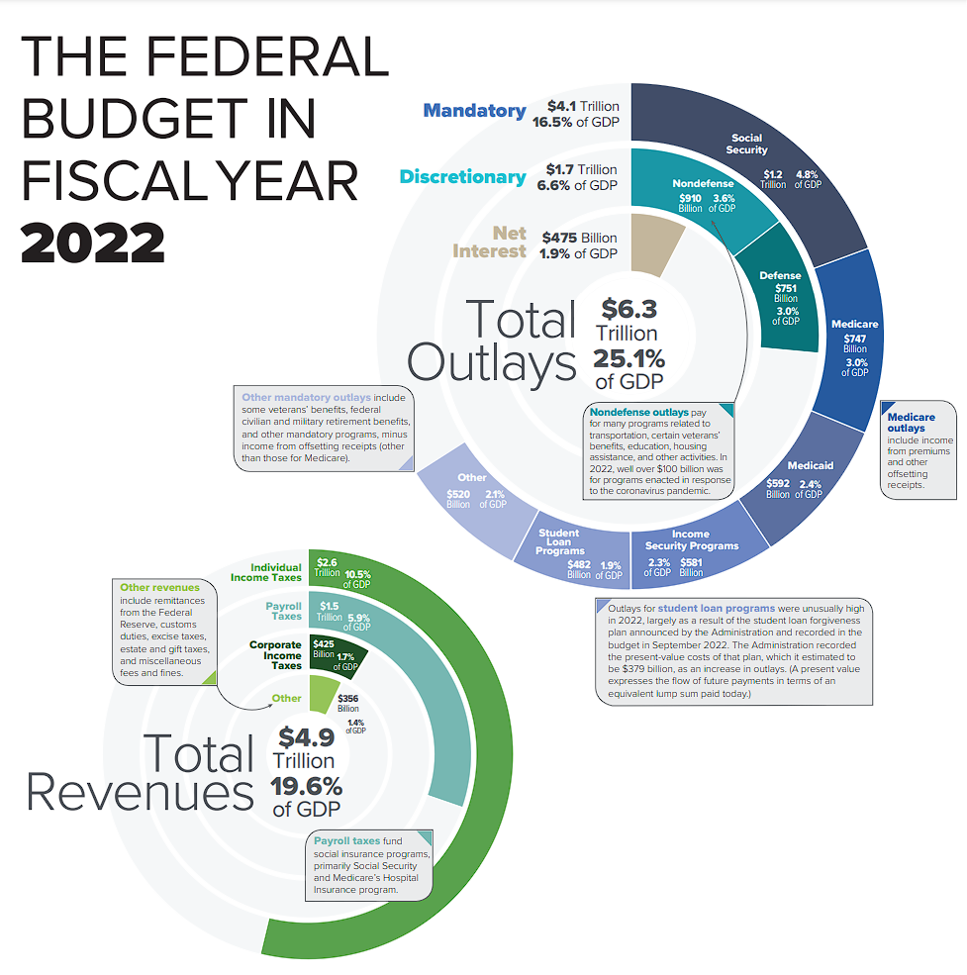
Federal Budget

Slide 95
Mandatory Spending
Mandatory spending, also known as direct spending, is mandated by existing laws. This type of spending includes funding for entitlement programs like Medicare and Social Security and other payments to people, businesses, and state and local governments. For example, the Social Security Act requires the government to provide payments to beneficiaries based on the amount of money they’ve earned and other factors. Last amended in 2019, the Social Security Act will determine the level of federal spending into the future until it is amended again. Due to authorization laws, the funding for these programs must be allocated for spending each year, hence the term mandatory.
House Committee Ways and Means has oversight on mandatory programs. They are responsible for raising federal revenue to finance the government. (Resolutions that have direct spending can be scrutinized)
Reference: House Committee Ways and Means

Slide 96
Discretionary Spending
Discretionary spending is money formally approved by Congress and the President during the appropriations process each year. Generally, Congress allocates over half of the discretionary budget towards national defense and the rest to fund the administration of other agencies and programs. These programs range from transportation, education, housing, and social service programs, as well as science and environmental organizations.
Continuing Resolution Authority (CRA) affects discretionary spending aka DoD

Slide 97

CBO
An Independent Government Agency for Cost Estimates

Slide 98
Reading a Cost Estimate Report

Slide 99
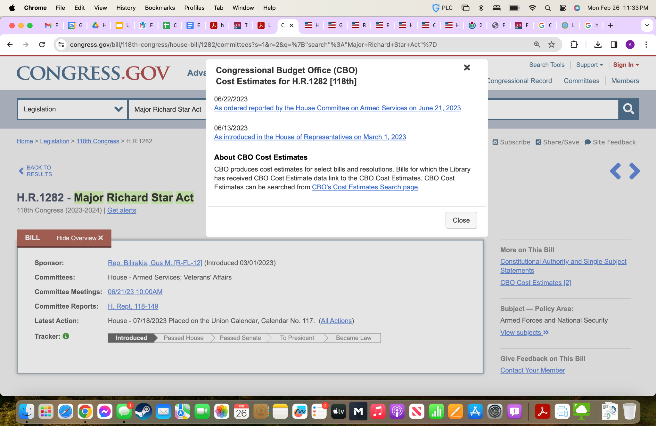

Slide 100
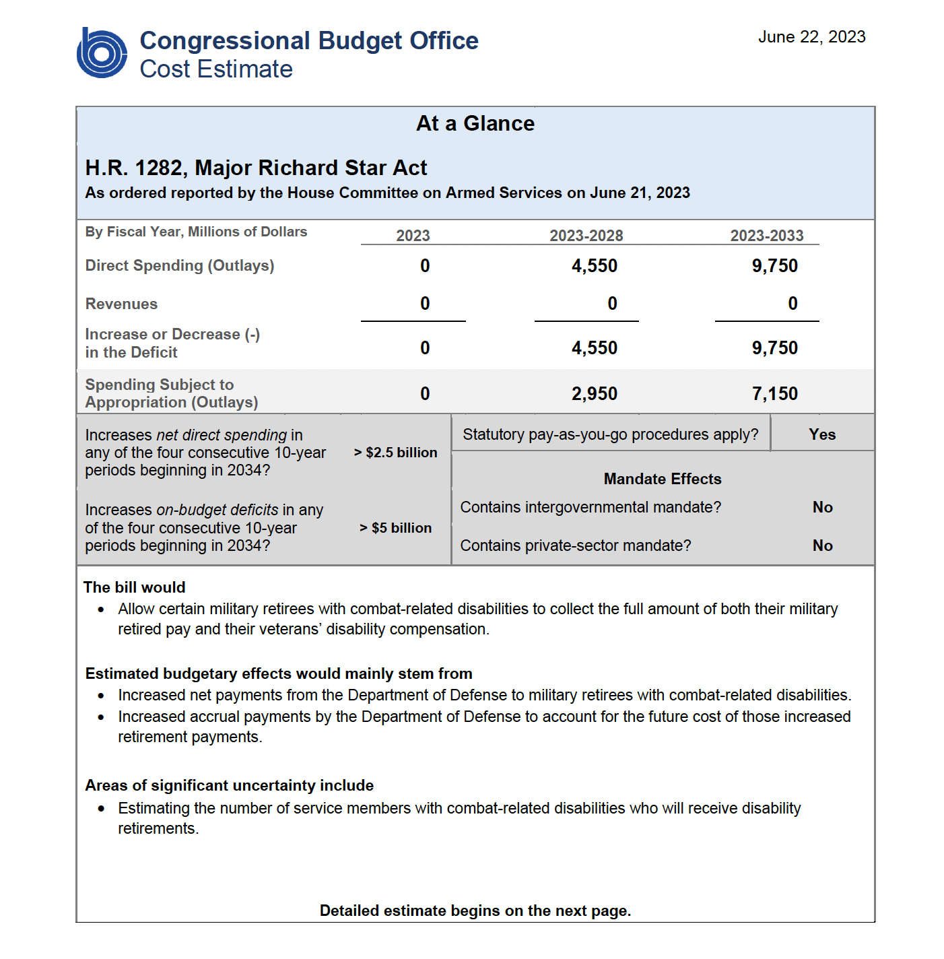
CBO Cost Estimate
Reference: H.R 1282 Major Richard Star Act

Slide 101
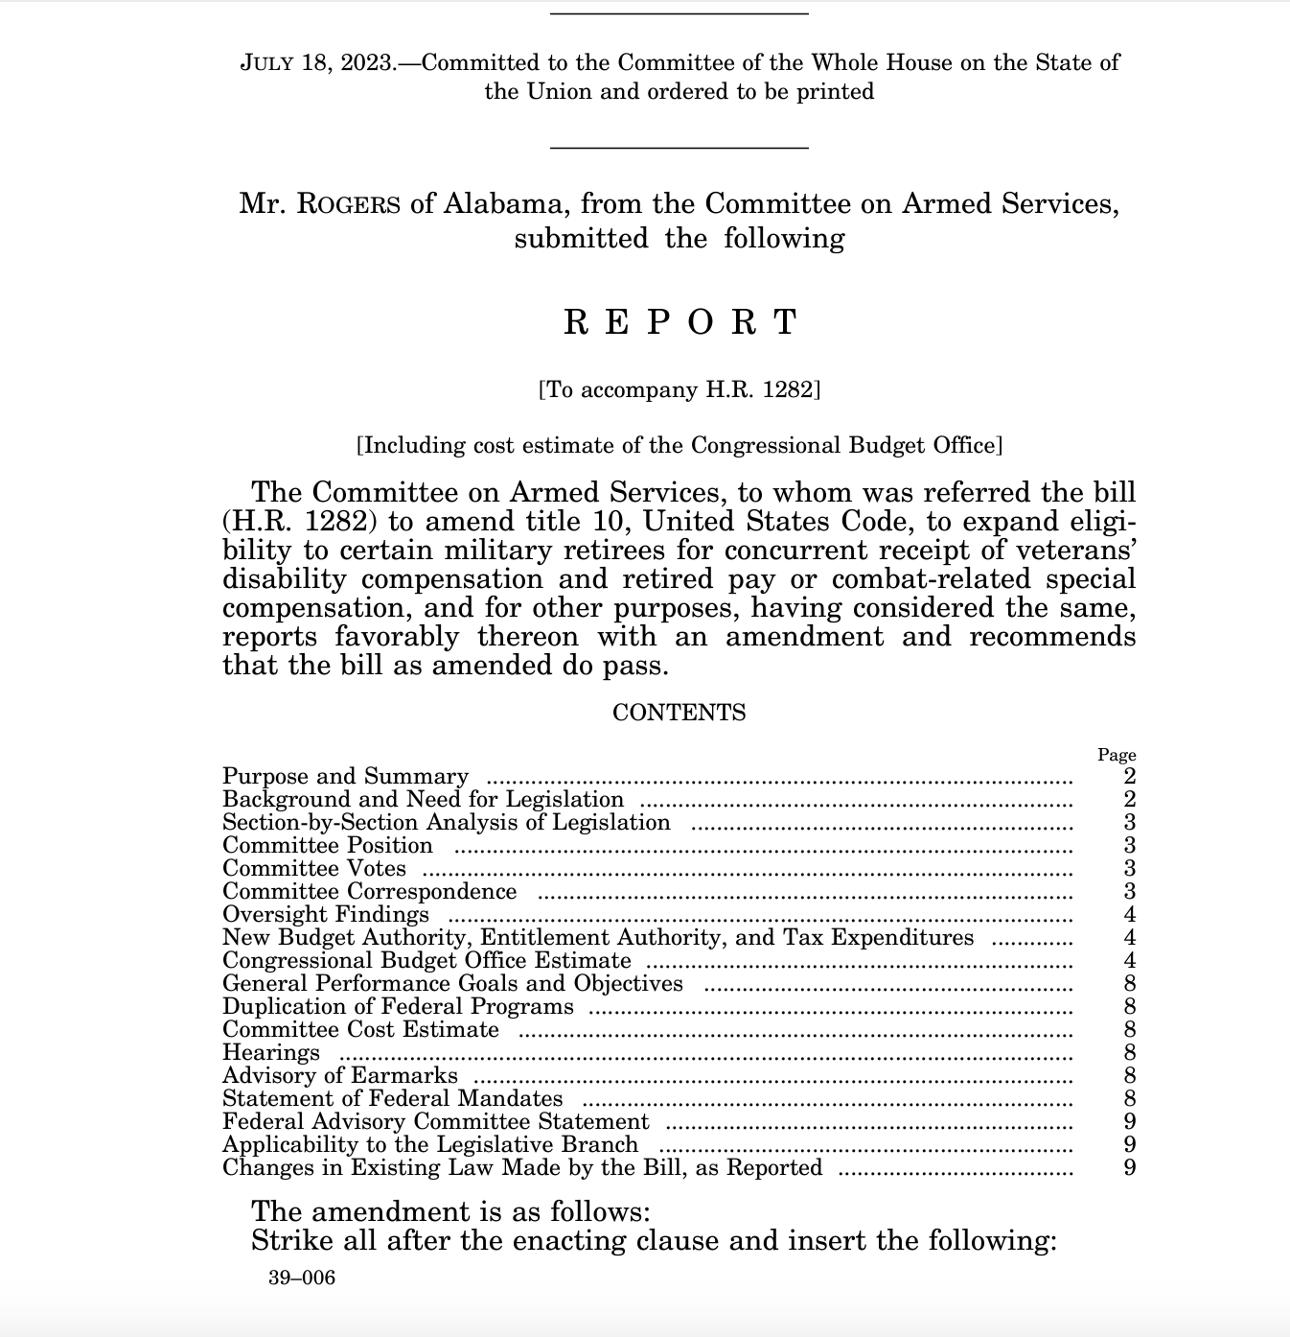
House Committee Report
Reference: House Armed Services Committee Report

Slide 102
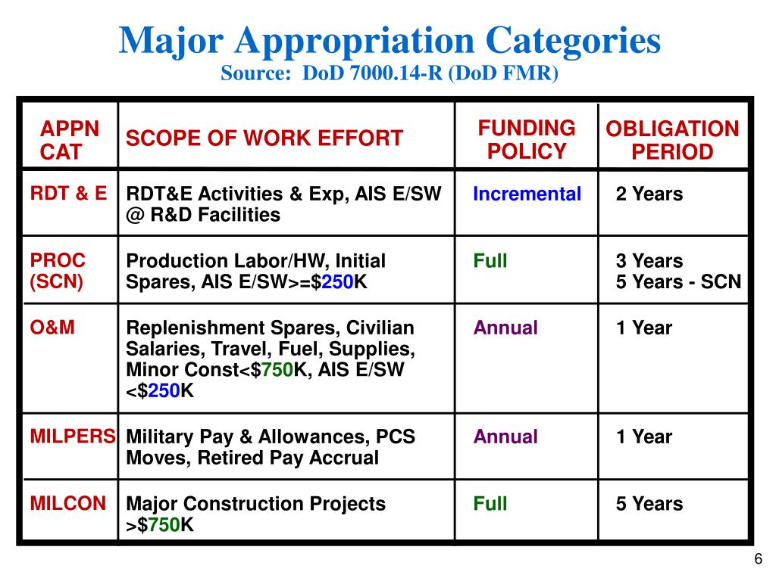
Colors of Money
Reference: Defense Acquisition University (DAU)

Slide 103
2024 Legislative Workshop
BREAK

Slide 104
EANGUS Point Papers
Jeremy Thompson
Jeff Frisby

Slide 105
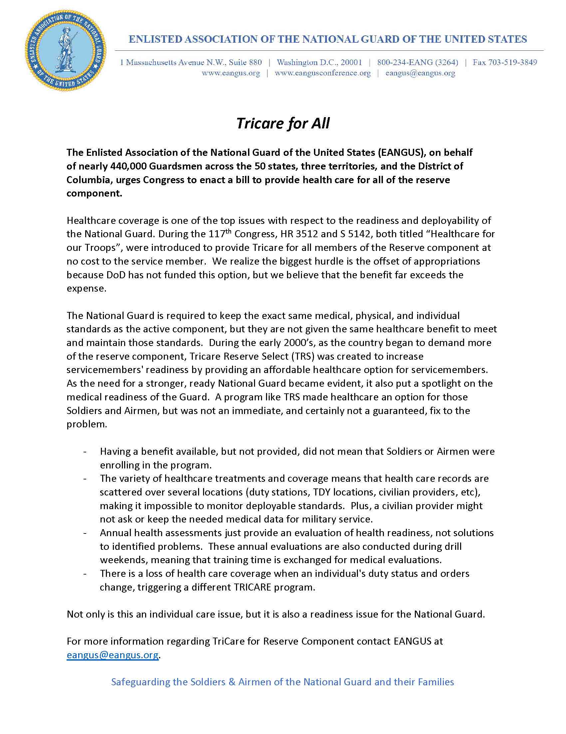

Slide 106
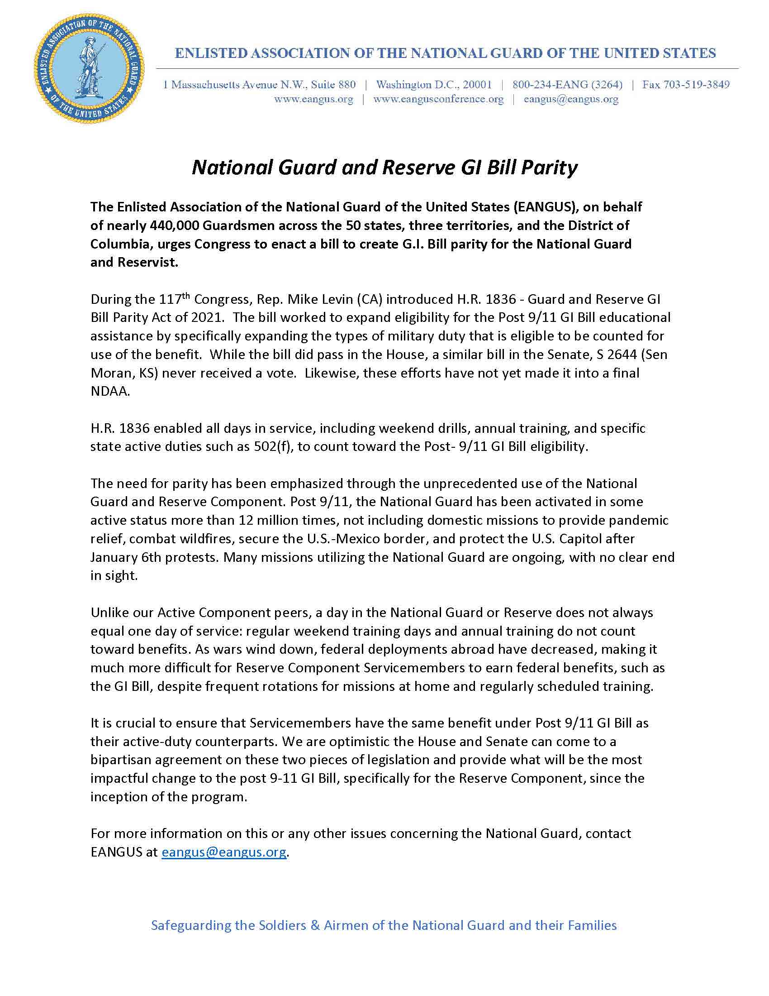

Slide 107


Slide 108
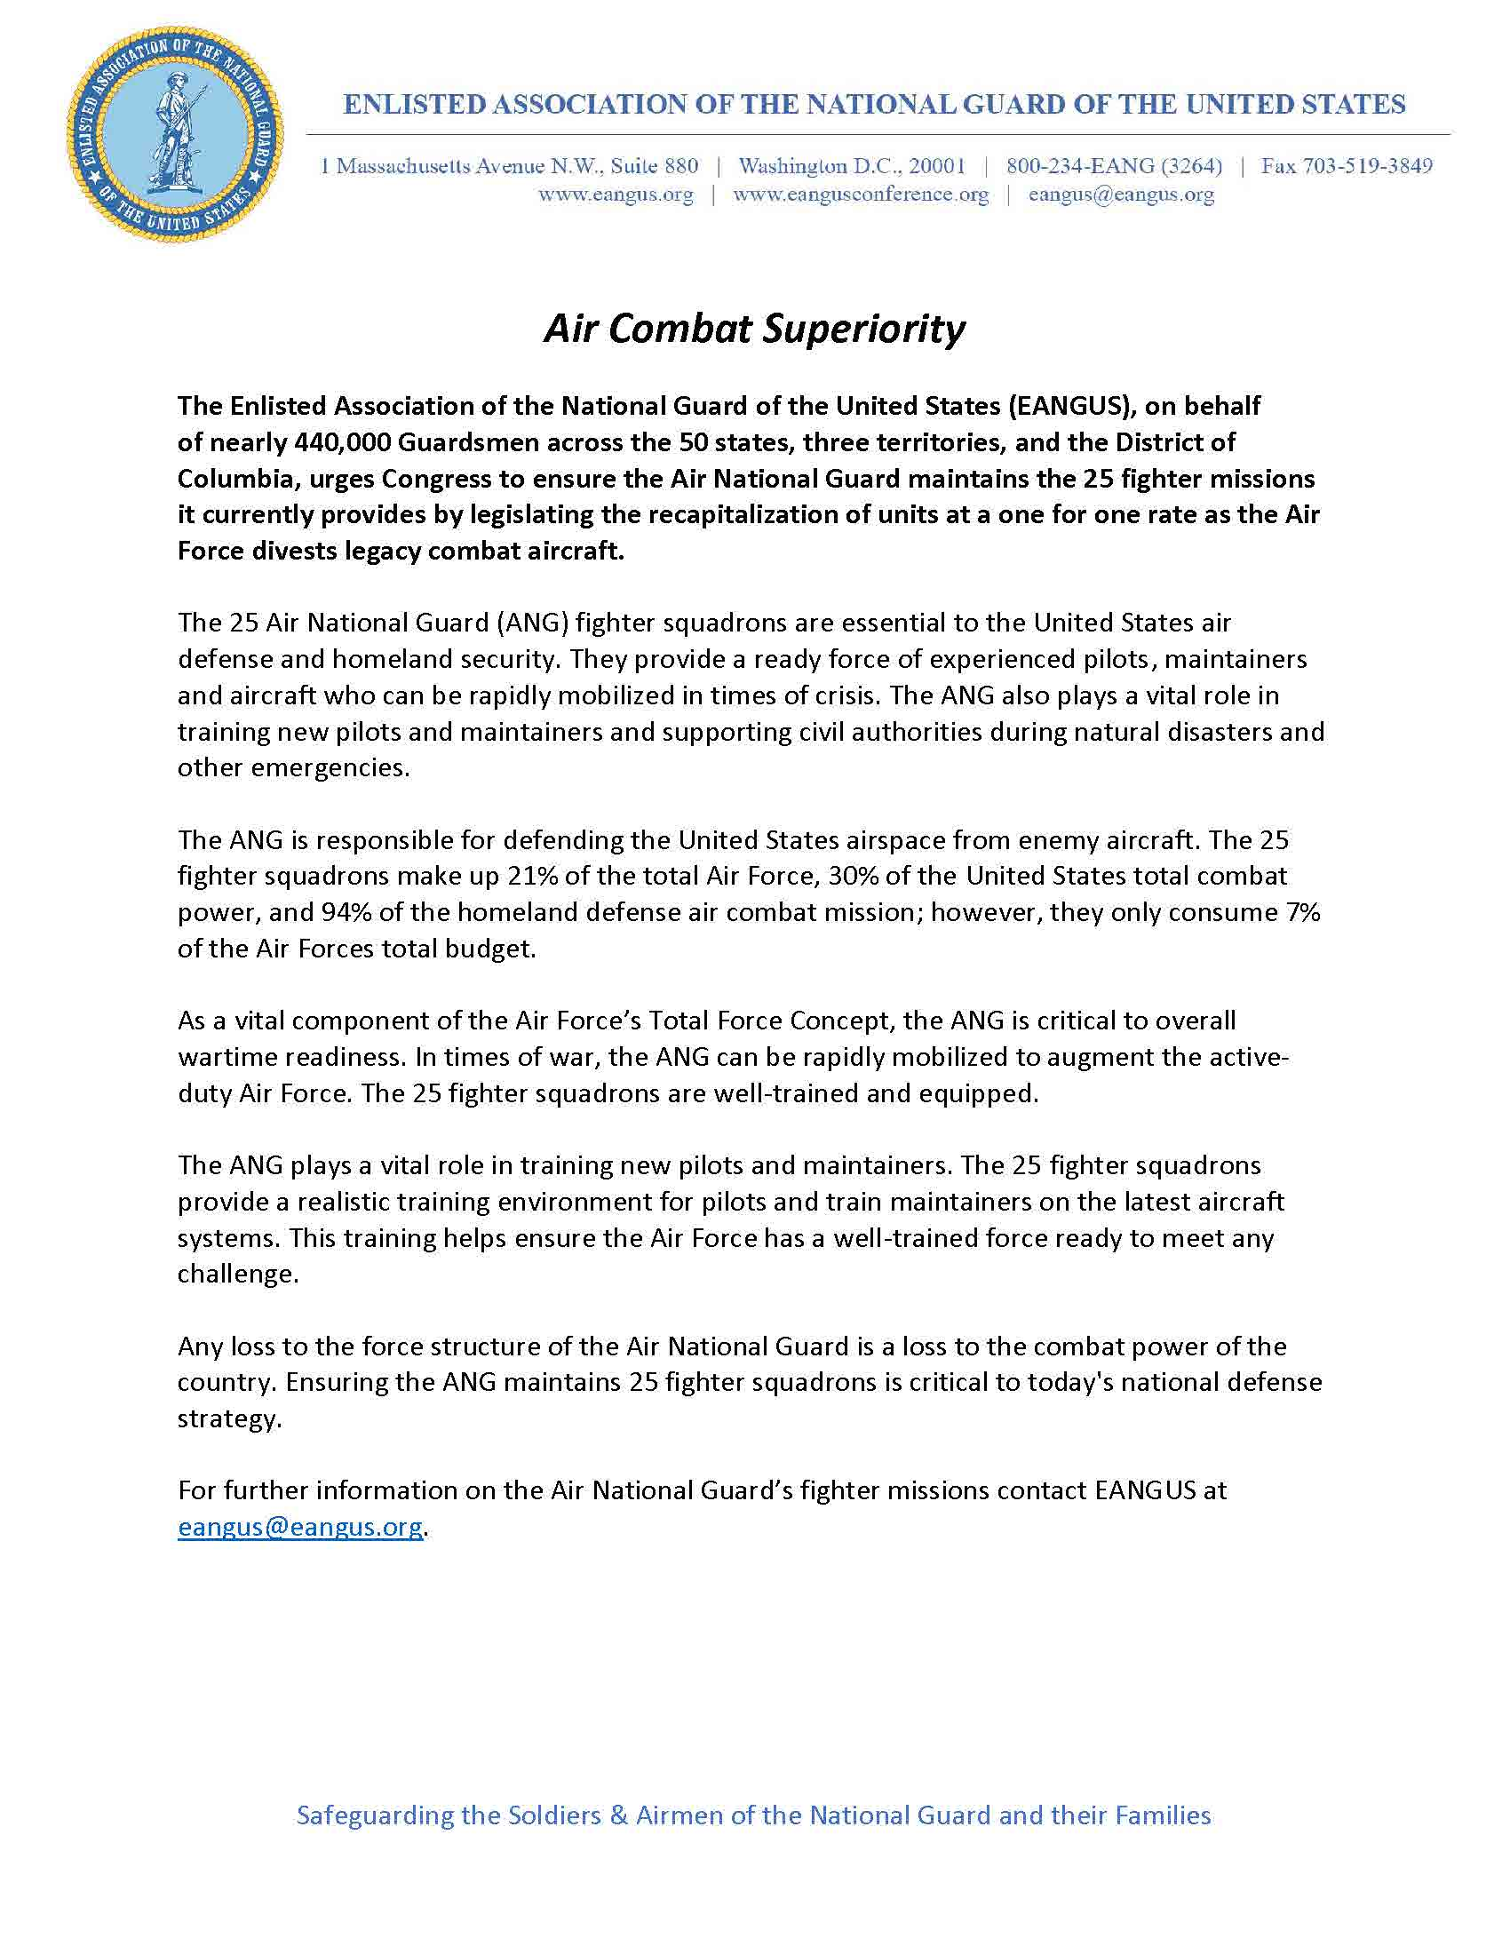

Slide 109
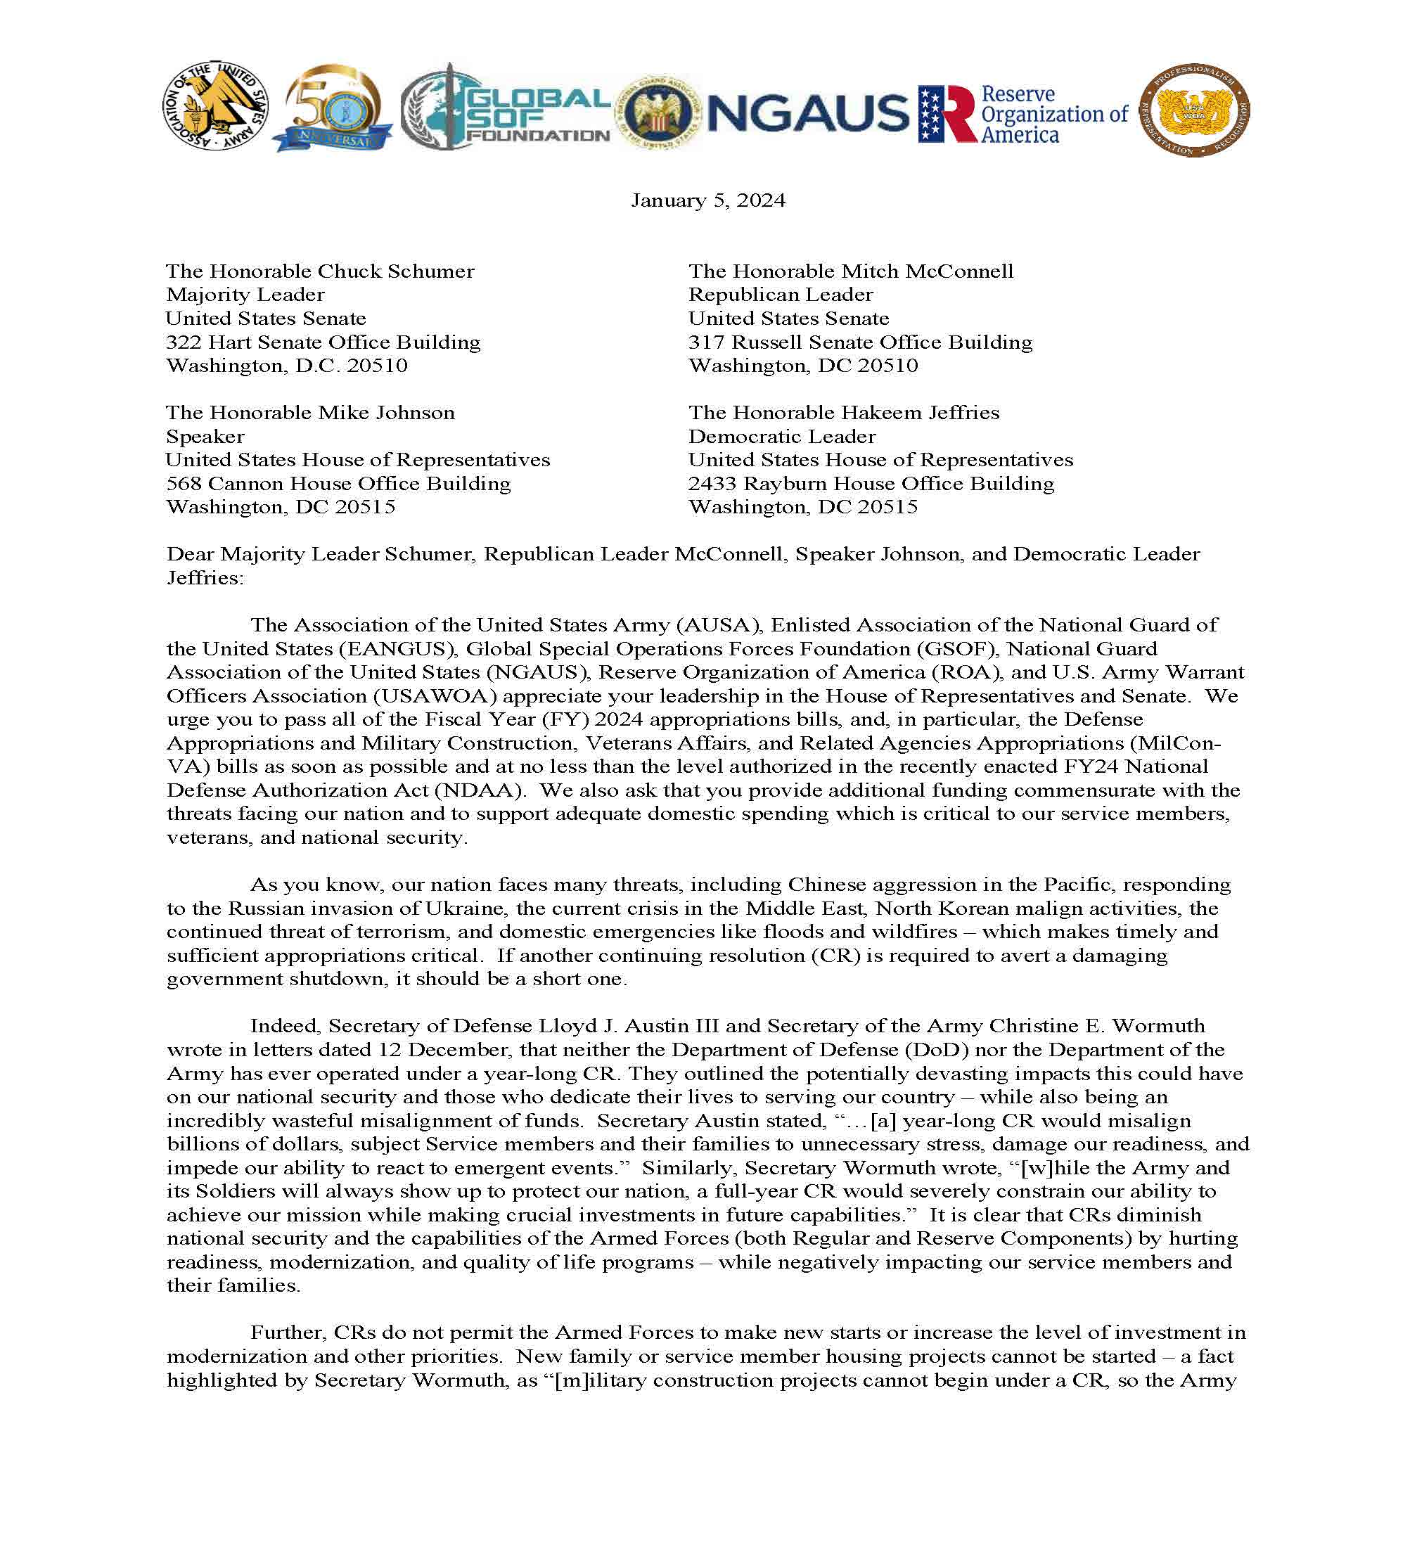

Slide 110
EANGUS Legislative Discussion

Slide 111
2024 State Presidents’ Workshop
Closing Comments
Admin Announcements
Sunday, 26 February 2024
1900 - 2100
Legislative Workshop No-Host Social
The Dubliner

Slide 112
Travel to Conflict Kinetics

